Slide 1

Capstone Project - The Battle of the Neighborhoods Portland Edition

Slide 2
Best Portland Neighborhood for Mexican Restaurant
My wife would like to open a Mexican restaurant in Portland.
We are new to the city and know very little about the neighborhoods.
I want to analyze the Portland neighborhoods and their venues through clustering and determine the best neighborhood to open a Mexican restaurant.

Slide 3
Data Acquisition and Cleaning
Collected 3 data sets for Portland neighborhood information:
Latitude and Longitude data from public.opendatasoft.com
Postal Code data from portlandneighborhood.com
Neighborhood venues data from Foursquare
30 neighborhoods were included in the initial data pull but only 27 returned venues from Foursquare and could be used in the analysis.
The data was then combined into multiple venue data frames to analyze the neighborhoods.

Slide 4
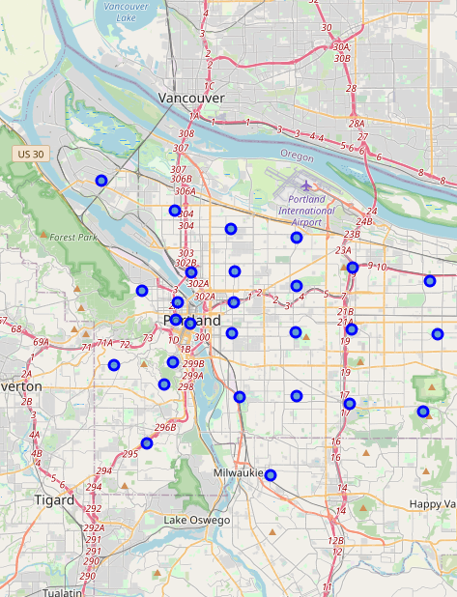
Visualizing the Neighborhoods
Vizualizing the neighborhoods helped see where they were in comparison to the center of the city as well as how far Portland expands outs.

Slide 5
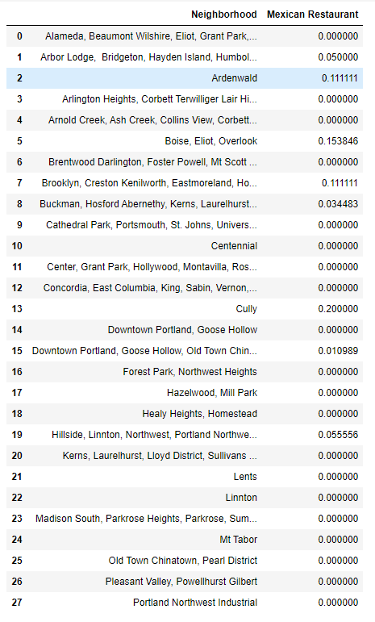
Mexican Restaurant Frequency per Neighborhood
Utilized one hot encoding to determine the frequency of each venue type in each neighborhood. I then used that output to determine the Mexican restaurants frequency in each neighborhood.

Slide 6
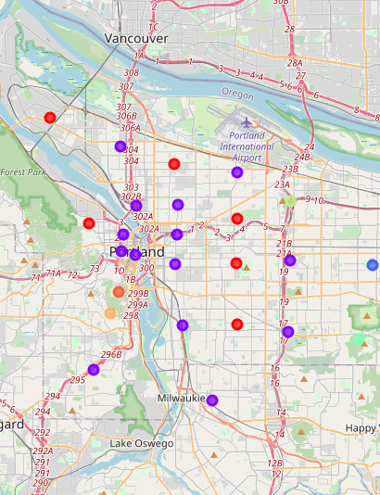
K-Means Clustering
Using K-Means clustering I could group the neighborhoods together by similar top venues and analyze the best areas to open a Mexican restaurant.

Slide 7
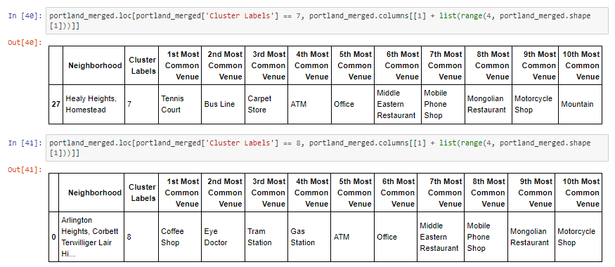
Conclusion
The two biggest clusters 0 and 1 are flooded with food trucks, coffee shops, and restaurants making them less ideal with that density already established.
Clusters 2 through 6 venues ranged from farms, offices to parks and mountains but all list a Mexican restaurant as a top 10 venues
The clusters 7 and 8 are not as food heavy and only list middle eastern and Mongolian restaurants listed in the top 10. Making these the best places to begin further analysis on determining the best Mexican restaurant location.

